Slide 1

AWS LAMBDA
SERVERLESS COMPUTING SIMPLIFIED
Since Nov 2014

Slide 2

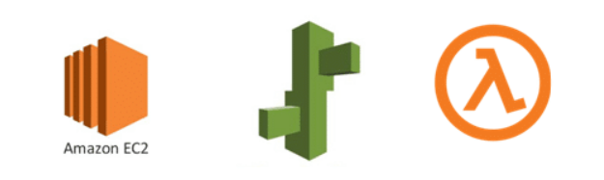
AWS COMPUTE OFFERINGS
AWS Elastic Compute Cloud (EC2)
AWS Elastic Beanstalk
AWS Lambda

Slide 3


WHAT IS AWS LAMBDA?
A stateless serverless compute service
Runs code in response to events
Automatically manages the compute resources

Slide 4

HOW AWS LAMBDA WORKS?
Event-Driven Model
Step 1:
AWS lambda supports, that is NodeJS, Java, Python, C# and, Go.
Upload AWS lambda code as a .zip file or container image.
The code we want Lambda to run is called Lambda function.
Step 2:
Event Source is the entity that triggers a Lambda Function. AWS services used to trigger a lambda function are:
Amazon S3, Amazon API Gateway, Dynamo dB, Amazon SNS, Amazon Kinesis, CloudFront, Amazon SES, CloudTrail, mobile app etc.
Step 3:
AWS Lambda function has the uploaded code and the event details on which the trigger has occurred.

Slide 5
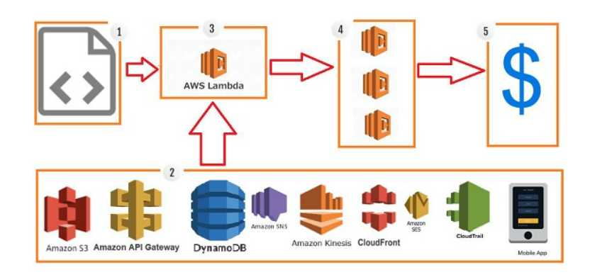
AWS Lambda Code is executed when triggered by AWS services under scenarios such as:
User uploads files in the S3 bucket
data is added/updated/deleted in Dynamo dB tables
http get/post endpoint URL is hit
push notification from SNS
real-time data streaming with AWS Kinesis
hosting of website, email sending, mobile app, etc.

Slide 6
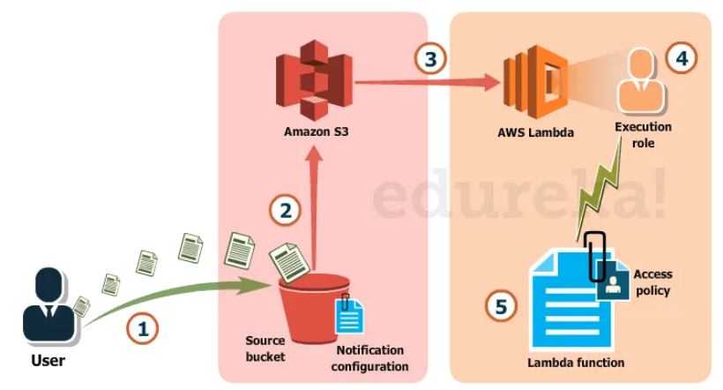
Example:
First, the user creates a Lambda function.
The user uploads the code to the Lambda function.
Then, the user uploads the image from the website to the S3 bucket as an object.
After receiving the object, the S3 bucket triggers the Lambda function.
The Lambda function does its job by resizing the image in the back-end and can send a successful completion email through SQS.

Slide 7
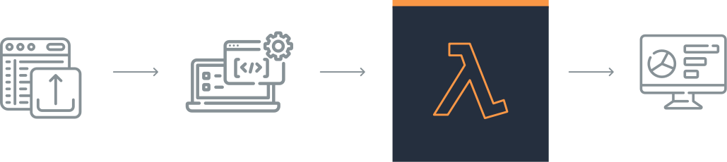
EXECUTION FLOW
Each Lambda function runs in its own container.
We can think of every lambda function as a standalone docker container.
Before the functions start running, each function’s container is allocated its necessary RAM and CPU capacity that parameters are configurable in AWS Lambda.

Slide 8
AWS LAMBDA PRICING
Based on the number of requests made: Pay only for the number of requests made on our Lambda functions.
1 million free requests per month.
Thereafter, pay 0.20$ /million requests
Based on the duration: The pricing here depends on the amount of memory we allocate to our functions:
400,000 GB-seconds free per month.
Thereafter, pay US$0.00001667 for every GB-second used.
Billed in increments of a minimum 100ms.
Note: GB-seconds are the number of seconds your function runs for, multiplied by the amount of RAM memory consumed.

Slide 9

BENEFITS
Flexibility:
Supports multiple programming languages such as Node.js, Python, Java, C#, and Go.
Scalability:
Automatically scales with demand and is highly available.
Pay-as-you-go:
Pay only for compute time.
Fully managed infrastructure:
Allows us to choose the memory and the timeout required for the code.
Save money on operational costs.
Can also execute parallel requests as per the event triggers.
Tight integration with other AWS products:
Integrated with S3, DynamoDB, and API gateway.

Slide 10
Log Provision:
Give details of the number of times a code was executed, the time taken for execution, the memory consumed, etc.
AWS CloudWatch collects all the logs, which helps in understanding the execution flow and debugging.
Ease of code authoring and deploying:
AWS online editor, Visual Studio IDE, IntelliJ or Eclipse IDE.
Besides AWS console, we have AWS-CLI to create and deploy code.
Fault tolerance
Faster time to market
No idle/cold servers

Slide 11
DISADVANTAGES
Latency while starting.
Limited control of infrastructure.
Need to carefully analyze code and decide the memory and timeout. Incase if function needs more time than what is allocated, it will get terminated as per the timeout specified on it and the code will not be fully executed. Max 900 seconds allowed.
The event request body cannot exceed more than 128 KB.
Since AWS Lambda relies completely on AWS for the infrastructure, you cannot install anything additional software if your code demands. For instance, Lambda functions write their logs only to CloudWatch.

Slide 12

USE CASES
1
2
3
Data Processing
Real-time file processing in S3
ETL data between Lambda & other services
Web Applications
Backend for web and mobile apps
Automation
Scheduled tasks and workflows.
Automated backups

Slide 13
BEST PRACTICES
Optimzing function performance:
By minimizing the cold starts & reducing the execution time by optimizing code and dependencies.
Efficient Resource Management:
Allocating the appropriate amount of memory to the function based on performance needs and cost considerations.
Error Handling:
Retry strategies: automatic retries for failed executions.
Dead Letter Queues (DLQ): capture failed events.

Slide 14
IAM Roles and Policies:
Grant the least privilege required for Lambda to perform its tasks.
AWS CloudWatch:
Monitor Lambda metrics such as invocation count, duration, error count.
Log function execution details.
VPC Integration:
Allow Lambda to access resources within a Virtual Private Cloud (VPC).
Enhances security and control over network traffic.
Environment Variables:
Capability to securely pass environment variables to our code, allowing us to configure critical parts of your system without having to modify the code itself.

Slide 15

ANY QUESTION?

Slide 16
THANK YOU
RAJVI UPADHYAY

Slide 17
